Slide 1

Seminar Report
Industry Practice
Name: Pranit Sanjay Pawar
Enrollment No: U101115FCS225
Course In charge: Ms. Geetica Shashank Ravi Chaudhary
University faculty mentor: Dr. Gaurav Varshney
OFF Campus faculty: Ms. Harini Madhusudhan
Company Mentor: Mr. Rajkumar Umakantham

Slide 2
Internship Role
At Cognizant Technology Solutions, there are 4 towers in the security sector:
DPP(Data Protection and Privacy), IAM(Identity and Access Management), ITM(Integrated Threat Management), IVM(Integrated Vulnerability Management), GRC(Governance and Risk Compliance).
My role is under the DPP tower which deals with masking, encrypting or obfuscating data and developing software for these purposes.
Developing products from a security focused perspective is the primary responsibility of my internship profile.
Testing the source code for vulnerabilities and checking for any unwanted outcomes is also a part of my role.

Slide 3

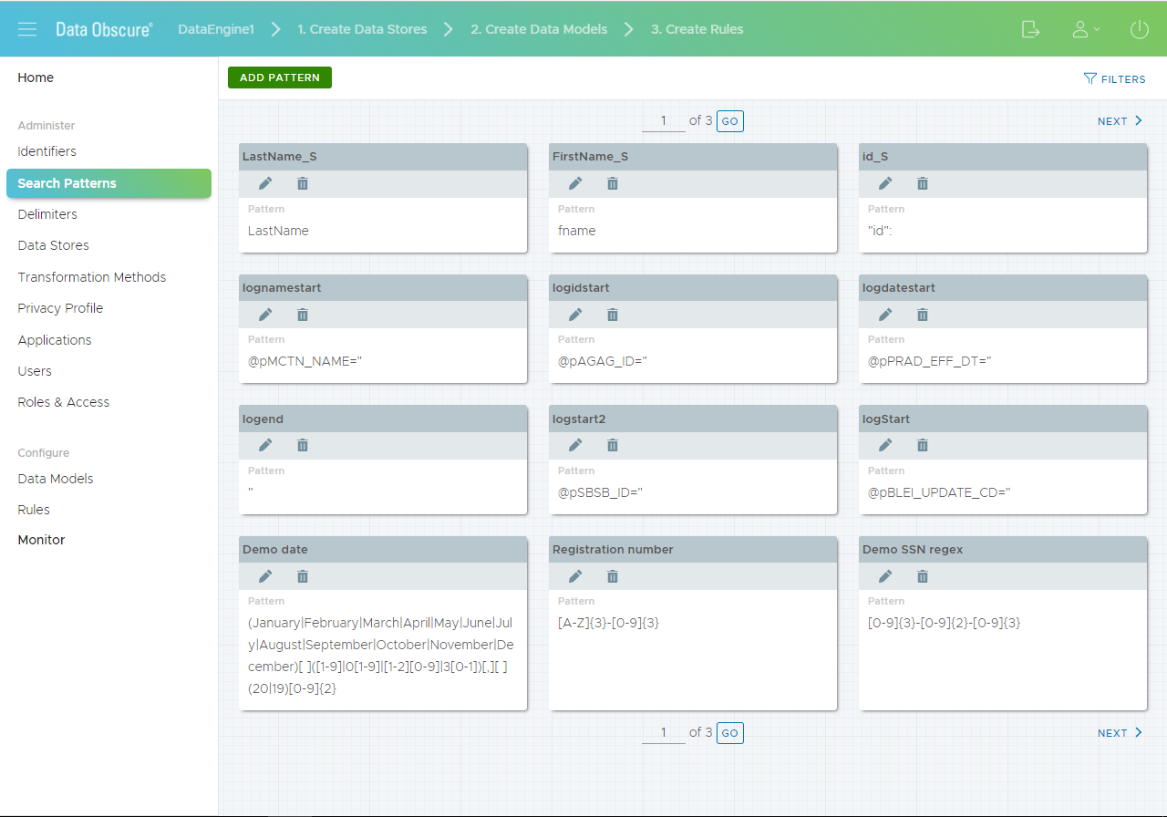
Project Description
My work here at Cognizant is associated with a security product developed and owned by Cognizant named a Data Obscure®.
Data Obscure® is a static data masking tool to facilitate data obfuscation over a variety of platforms.
It provides integration with a simple file system to complex mainframes, making it a viable enterprise solution for data masking.

Slide 4
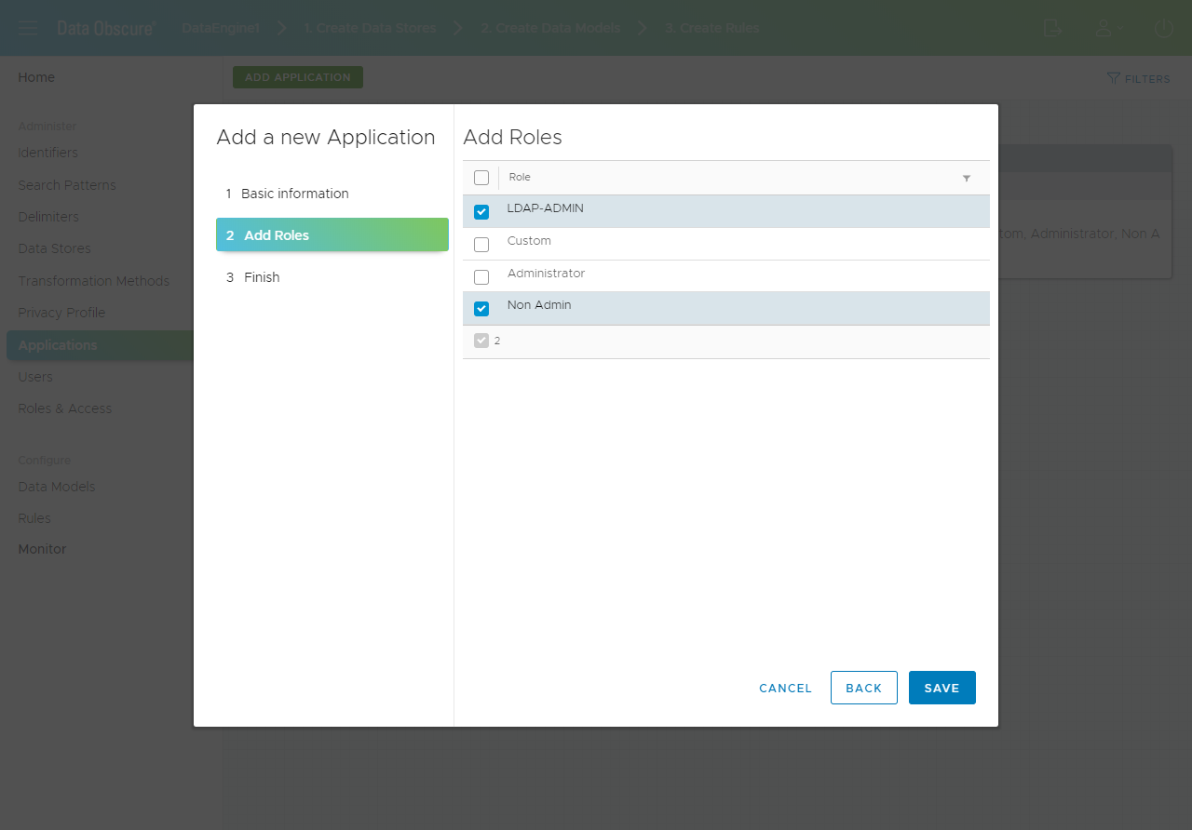
Project Description
Supports variety of data formats:
Data Extracts including, delimited, quoted delimited, and fixed length files.
All X12 formats, including EDI.
XML.
VSAM and ISAM.
Files with mixed record formats.
Microsoft SQL server and Oracle.
JSON

Slide 5
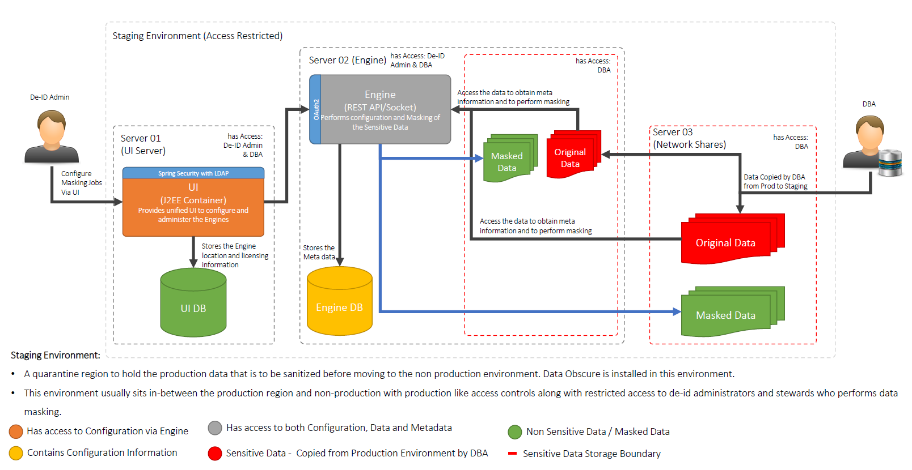
Project Design

Slide 6
Objectives
Version control systems offer a lot of functionality in terms of maintaining changes and related information in a coherent and nondestructive way.
To adopt version control in applications usually requires a wrapper to be developed for the particular flavor of version control.
The aim is to develop an integration wrapper that can be integrated with the existing application to connect to a version control system.
The solution should support all primary functions of the version control system (check-in, check-out, and conflict resolution).
The solution should support user authentication with SVN and Git.
The solution should support SVN and Git. System should have interfaces for applications to integrate.
Solution should be cross-platform.
The solution should be extendable for future additions of other version control systems

Slide 7






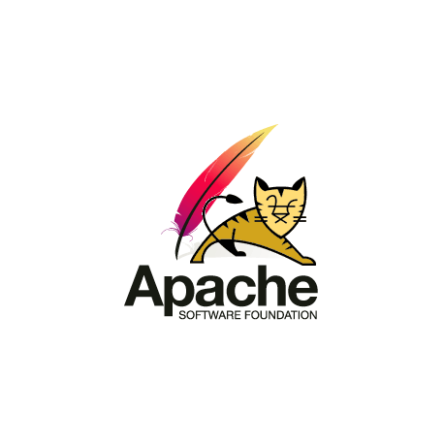

Technologies Used
VS Code - Preferred IDE for development
JGIT - API for communicating with the GIT based repositories written in pure java.
SVN Kit - API for communicating with the SVN based repositories written in pure java.
Java
Maven - Managing, Installing and packaging the project.
Apache Tomcat – Server for running the web application.
AngularJS – Front end for web application.
Spring Framework - application development framework for enterprise Java.

Slide 8
Technical Challenges
Had to learn all the inner details of how a version control system works.
Had to learn to different APIs for developing wrapper for integrating it into the main product.
Difficulty in understanding the usage of APIs due to lack of proper documentation.
Understanding some advanced java topics such as Concurrency, Web Services, Spring.
Had trouble integrating the developed solution into the final product.
Had a issue where Java’s TLS library is unable to communicate on corporate networks. The problem was narrowed down to issue regarding self signed certificates implemented by the company.
Found a workaround for manually adding certificates and CA to java’s TLS library.

Slide 9
Learning Experiences
Met some industry veterans who have been in this field for about 15 to 20 years and were explained the importance of security and learning while working. Got to know the importance of building contacts and network to progress more rapidly. Learned some topics such as Disaster Recovery, SOX Compliance, PCI DSS Compliance, etc. and why are they crucial for a business. Was guided by an industry expert in how an organization must approach, implement and get certified by different standards depending on the use case. This was my first time working in a team and following a certain software development life cycle. Got to learn requirements analysis, project planning, time management, importance of documentation.

Slide 10
Outcome/Result
The solution developed by me was packaged into a .jar which can be implemented and used by the rest of the team.
Also integrated the solution in the final production ready application.
The changes will be incorporated in the next version bump of the product.

